Slide 1
Introduction to
MATLAB

Slide 2
Basic operations
Input/Output of Data
Matrices and arrays
Operations on vectors and matrices
Functions inside Matlab
Saving the variable’ values
2-D visualization

Slide 3
Basic operations
  Example 1
  >> a=1; b=3;
  >> a + b
  ans = 4
  Example 3
  >> a=2; b=3; c=5.5;
  >> d=a+b+c
  d = 10.5000
  Example 2
>> a=1; b=3;
>> c=a+b+1
c = 5
  Example 4
  >> a=2; b=3; c=5.5;
  >> d=a^2+3*b+c/2;
  d = 15.7500

Slide 4
Basic operations
  >> who
  Your variables are:
  a b c d
>> whos
Name Size Bytes Class
a 1x1 8 double array
b 1x1 8 double array
c 1x1 8 double array
d 1x1 8 double array
Grand total is 4 elements using 32 bytes

Slide 5
Input/Output of Data using keyboard
  The command ‘input’ enables the user to input some
  data via the keyboard.
  For example,
  >> x=input(' Enter x: ')
  Enter x: 1/3
  x = 0.3333 % short form (default)
  >>format rat % as a rational number
  >> x
  x = 1/3

Slide 6
Input/Output of Data using keyboard
  >>format short % short form (default)
  x = 0.3333
  >>format long % as a decimal number with 14 digits
  >> x
  x = 0.33333333333333
  >> format long e % as a long exponential form
  >> x
  x = 3.333333333333333e-001

Slide 7
Statement disp()
  There are other ways of displaying the value of
  variable on the screen.
  Two useful commands are ‘disp()’ and ‘fprintf()’:
  >>disp('The value of x = ‘), disp(x)
  The value of x =
  0.3333

Slide 8
Statement fprintf()
  Type specifier Printing form:
  fprintf(‘format string’,variable)
  %c character type
  %s string type
  %d decimal integer type
  %f floating point type
  %e decimal exponential type
  Special character Meaning
  \n New line
  \t Tab
  \b Backspace

Slide 9
Statement fprintf()
  Examples:
  >> a=2;
  >> fprintf('Variable a = %d\n', a);
  Variable a = 2
  >> a=66;
  >> fprintf('Variable a = %c\n', a);
  Variable a = B

Slide 10
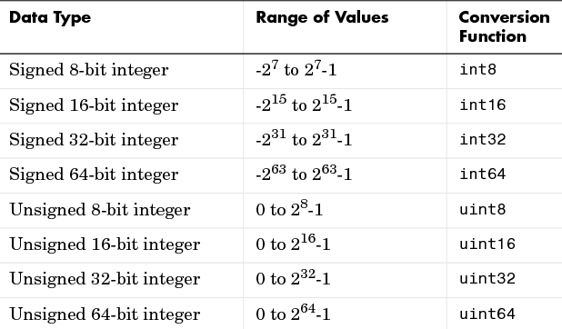
Conversion to integers

Slide 11
Conversion to integers
  Examples:
  >> a=2.345;
  >> int8(a)
  ans = 2
  >> str = ‘Hello World’;
  >> int8(str)
  ans = 72 101 108 108 111 32 87 111 114 108 100

Slide 12
Constructing a matrix
  A = 1 2 3 B = 3 C = 1 -2 3 6
  4 5 6 -2
  >>A=[1 2 3; 4 5 6 ] A=[1, 2, 3; 4, 5, 6 ]
  >>B=[3; -2; 1]
  >>C=[1 -2 3 6]
  >> whos A B C
  Name Size Bytes Class
  A 2x3 48 double array
  B 3x1 24 double array
  C 1x4 32 double array

Slide 13
Constructing a matrix
  MATLAB has a number of functions that create
  different kinds of matrices:
  ones() Create a matrix of all ones
  zeros() Create a matrix of all zeros
  eye() Create a matrix with ones on the diagonal and zeros elsewhere
  rand() Create a matrix of random numbers distributed between zero and one

Slide 14
Constructing a matrix
  Example 1
>> A=ones(3)
A = 1 1 1
1 1 1
1 1 1
  Example 2
>> B=ones(2,3)
B = 1 1 1
1 1 1
  Example 3
>> A=rand(3,2)
A = 0.6154 0.7382
0.7919 0.1763
0.9218 0.4057
>> B=A*10
B = 6.1543 7.3821
7.9194 1.7627
9.2181 4.0571

Slide 15
Constructing a matrix
  Example 4
>> Z=zeros(2,3)
Z = 0 0 0
0 0 0
  Example 5
>> I=eye(3)
I = 1 0 0
0 1 0
0 0 1
  Example 6
  >> Y=int8(rand(3,2)*10)
Y = 10 5
2 9
6 8
>> X=Y‘
X = 10 2 6
5 9 8

Slide 16
Operations on vectors and matrices
  Example 1
>> A=[1 2 3;4 5 6]
>> B=[3;-2;1]
>>A =[A; 7 8 9 ]
A= 1 2 3
4 5 6
7 8 9
  Example 2
>> B=[B [1 0 -1]’]
B = 3 1
-2 0
1 -1
  Example 3
>> A(3,3)=0
A = 1 2 3
4 5 6
7 8 0
>> A(2:3,1:2)
ans = 4 5
7 8
>> A(2,:)
ans = 4 5 6

Slide 17
Operations on vectors and matrices
  Example 4
>> t=0:3
t = 0 1 2 3
>> t=0:0.5:3
t= 0 0.5 1 1.5 …2.5 3
  Example 5
>> D(2)=2; D(4)=3;
D = 0 2 0 3
  Example 6
>> R=rand(2,3)
>>size(R,1) %rows’ number
ans = 2
>>size(R,2) %cols’ number
ans = 3
>>size(D,1)
ans = 1
>>size(D,2)
ans = 4

Slide 18
Operations on vectors and matrices
  Example 7
>> a=[1 2 3]
>> b=[3 2 1]
>> a*b
Error using
>> a*b’
ans = 10
>> a.*b
ans = 3 4 3
  Example 6
>> R=rand(2,3)
>>size(R,1) %rows’ number
ans = 2
>>size(R,2) %cols’ number
ans = 3
>>size(D,1)
ans = 1
>>size(D,2)
ans = 4

Slide 19
Functions inside Matlab
cos(x)
sin(x)
tan(x)
log(x)
abs(x)
sqrt(x)
log(x)
exp(x)
max(x,y)
min(x,y)
mod(y, x)
round(A) the nearest integer
fix(A) the nearest integer toward 0
sort(A)
A = rand(2)*10
A = 4.5647 8.2141
0.1850 4.4470
round(A)
ans = 5 8
0 4
fix(A)
ans = 4 8
0 4
B=[2 0 5 1];
sort(B)
ans = 0 1 2 5

Slide 20
Input/Output of Data through Files
Saving the variables’ values into MAT-files
Matlab can handle two types of data files.
One is the binary format MAT-files named *.mat. It can preserve more than one variable, but will be handled only in the Matlab environment.
  >> save file1 %saving of MAT-file
  >> save c:\matlab701\work\curr_file
>> load file1
  >> load c:\matlab701\work\curr_file

Slide 21
Input/Output of Data through Files
Saving the variable’ values into a file
The other is the ASCII dat-file named *.dat, which can be shared with other environments, but can preserve the values of only one variable.
  >> A = rand(4,3)
  save temp.dat A /ascii
  A =
  0.6449 0.2897 0.3093
  0.8180 0.3412 0.8385
  0.6602 0.5341 0.5681
  0.3420 0.7271 0.3704

Slide 22
Opening files
Before reading or writing a text or binary file, you must open it
fid = fopen(‘filename’, ‘mode’);
Mode | Meaning
r | read only (need an existed file)
w | write only (delete an existed file)
a | append (to an existed file or a new file)
r+ | read and write to an existed file
w+ | write and read (delete file if existed)
a+ | append and read file

Slide 23
Input/Output comands
Example: File far.m
f=input('Input the temperature in Fahrenheit[F]: ');
c=5/9*(f-32);
fprintf('%5.2f(F) is %5.2f[C].\n', f, c);
fid=fopen('file.dat', 'w');
fprintf(fid, '%5.2f(F) is %5.2f[C].\n', f, c);
fclose(fid);

Slide 24
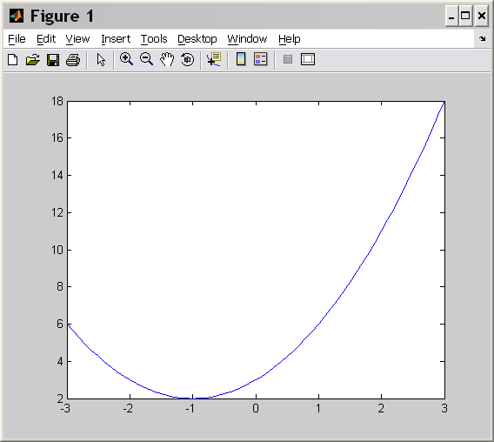
2-D visualization. Graphics
>> x=[-3:3]
x = -3 -2 -1 0 1 2 3
>> plot(x,x.^2+2*x+3)
>> x=[-3: 0.1: 3]
>> plot(x,x.^2+2*x+3)

Slide 25
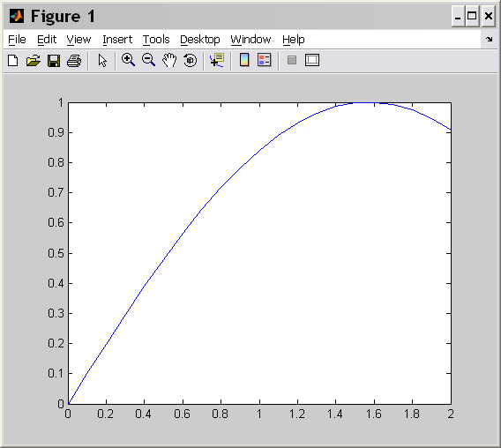
2-D visualization. Graphics
>> x=0: 0.1: 2
>> y =sin(x)
>> plot(x, y)
>> x=0: 0.1: 2
>> z =cos(x)
>> plot(x, z)

Slide 26
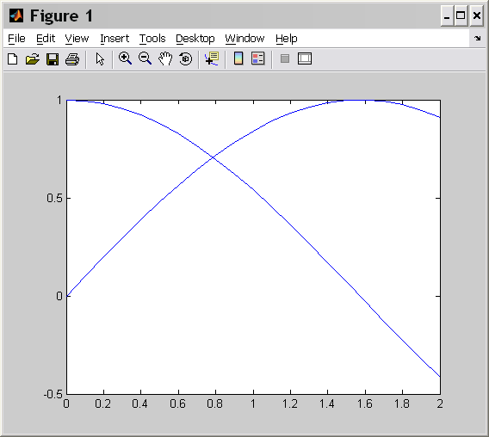
2-D visualization
>> plot(x, y);
>>hold on
>> plot(x, z);
>>plot(x,y,x,z);

Slide 27
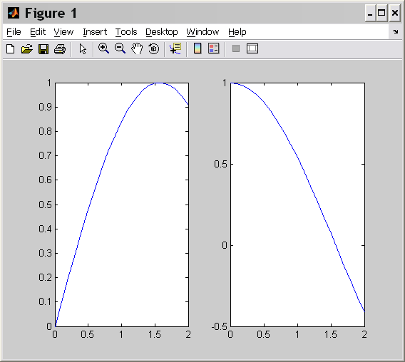
2-D visualization
>> subplot(1,2,1);
>>plot(x, y);
>> subplot(1,2,2);
>> plot(x, z);

Slide 28
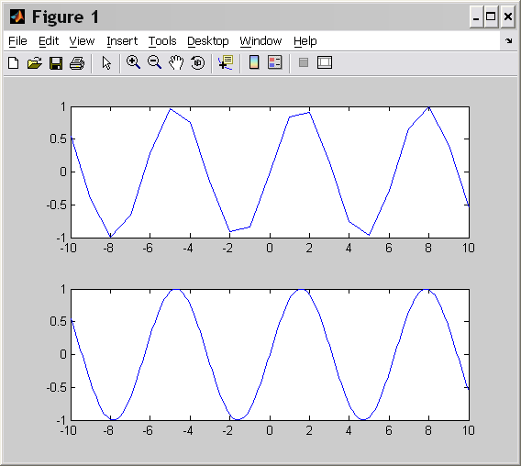
2-D visualization
>> x=-10: 10;
y=sin(x);
subplot(2,1,1);
>>plot(x, y);
>> x=-10: 0.1: 10;
y=sin(x);
subplot(2,1,2);
>>plot(x, y);

Slide 29
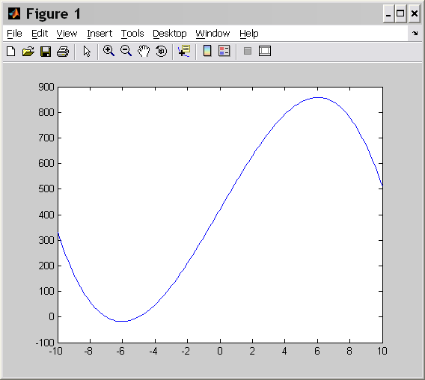
Example
x = [-10: 0.1: 10]
>> plot(x, 3*x.^2 +2*x-7);
>> plot(x,-(x+5).*(x-12).*(x+7));
>> plot(x,sin(x)-cos(x));

